Slide 1
Principles of Operations Management (LGT2106/LGT2B02)
Lecture 3
Forecasting

Slide 2
Lecture outline
Demand management
Independent demand and dependent demand
Components of demand
Forecasting
Types of forecasting
Time series analysis
Simple moving average
Weighted moving average
Exponential smoothing
Forecast error (MAD, ME and MAPE)
Linear regression
Causal relationship
Applications of forecasting to service operations

Slide 3
Forecasting is a vital function
Forecasting is a vital function and affects every significant management decision
Finance and accounting use forecasts as the basis for budgeting and cost control
Marketing relies on forecasts to make key decisions such as new product planning and personnel compensation
Production uses forecasts to select suppliers; determine capacity requirements; and drive decisions about purchasing, staffing, and inventory

Slide 4
Independent demand and dependent demand
Independent demand
The demands for various items are unrelated to each other
Dependent demand
The need for any one item is a direct result of the need for some other item
Usually a higher-level item of which it is part

Slide 5
Independent demand and dependent demand example
Independent demands
Dependent demand

Slide 6
Demand management
Coordinate and control all sources of demand
Not much a firm can do about dependent demand
It is demand that must be met
There is a lot a firm can do about independent demand
Take a passive role and respond to demand
Take an active role to influence demand

Slide 7
Components of demand
Average demand for a period of time
Trends
Seasonal influence
Cyclical elements
Random variation

Slide 8
Components of demand

Slide 9
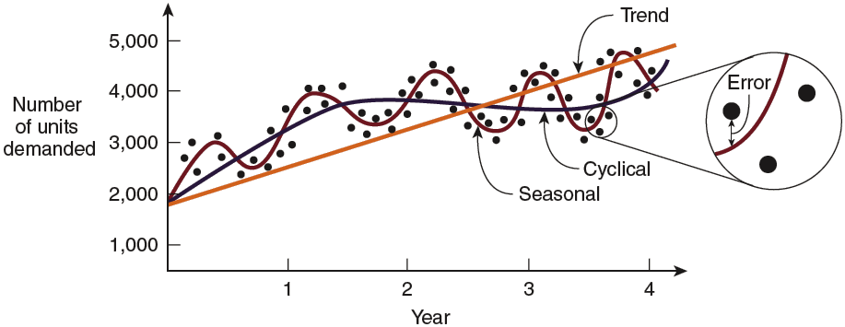
Components of demand

Slide 10
Common types of trends

Slide 11
Types of forecasting
Qualitative techniques
Non-quantitative forecasting techniques based on expert opinions and intuition
Typically used when there are no data available
Time series analysis
Analyzing data by time periods to determine if trends or patterns occur
Causal relationship forecasting
Relating demand to an underlying factor other than time
Simulation

Slide 12
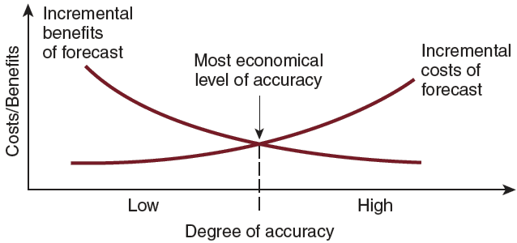
Costs and benefits of forecasting
Accenture: https://youtu.be/kKm8noEnl5w

Slide 13
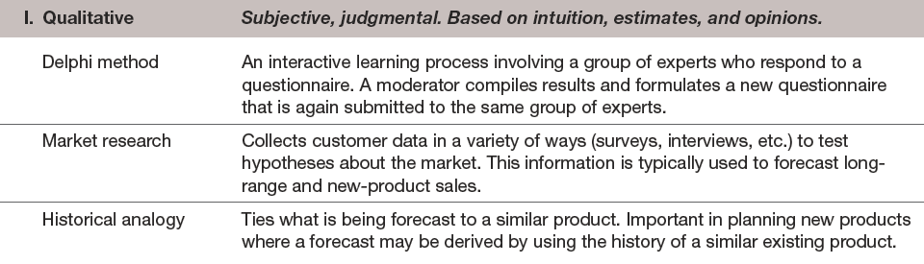
Forecasting techniques and common models

Slide 14
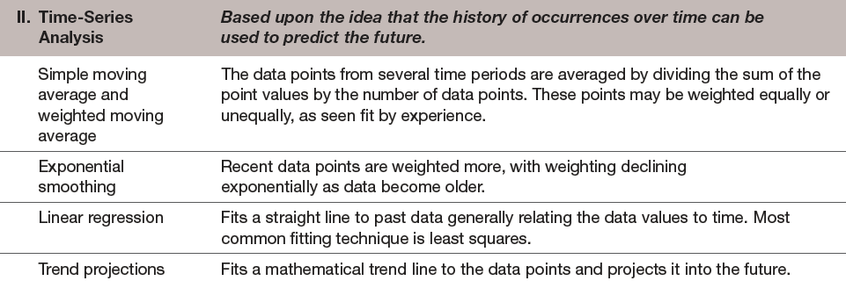
Forecasting techniques and common models

Slide 15
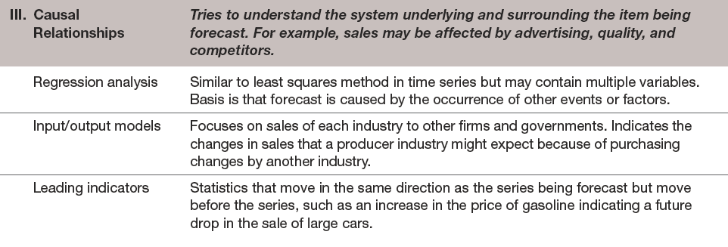
Forecasting techniques and common models

Slide 16
Forecasting model selection
Time horizon to forecast
Accuracy required
Data availability
Size of forecasting budget
Availability of qualified personnel

Slide 17
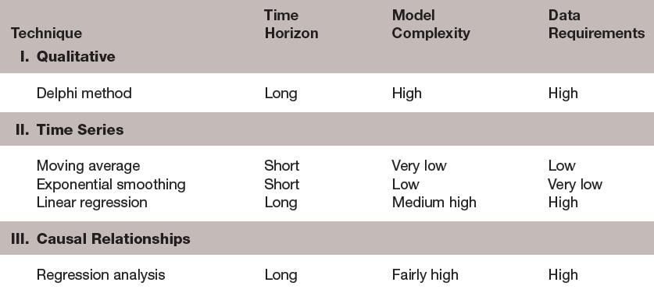
Comparison of forecasting techniques

Slide 18
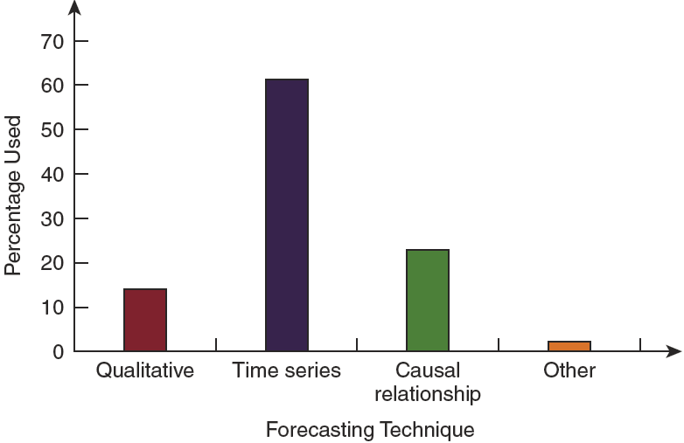
Forecasting techniques used in business

Slide 19
Simple moving average
Average over a given number of time periods that is updated by replacing the data in the oldest period with that in the most recent period
Useful when demand is neither growing nor declining rapidly and does not have seasonal characteristics
Important to select the best period
Longer gives more smoothing
Shorter reacts quicker to trends

Slide 20
Simple moving average
…

Slide 21
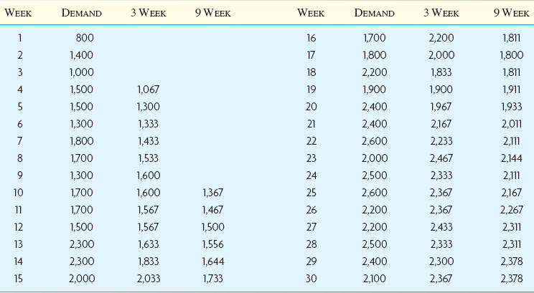



Simple moving average example
$$\frac{1000+1400+800}{3}=1067$$
$$\frac{1500+1000+1400}{3}=1300$$
$$\frac{1500+1500+1000}{3}=1333$$

Slide 22
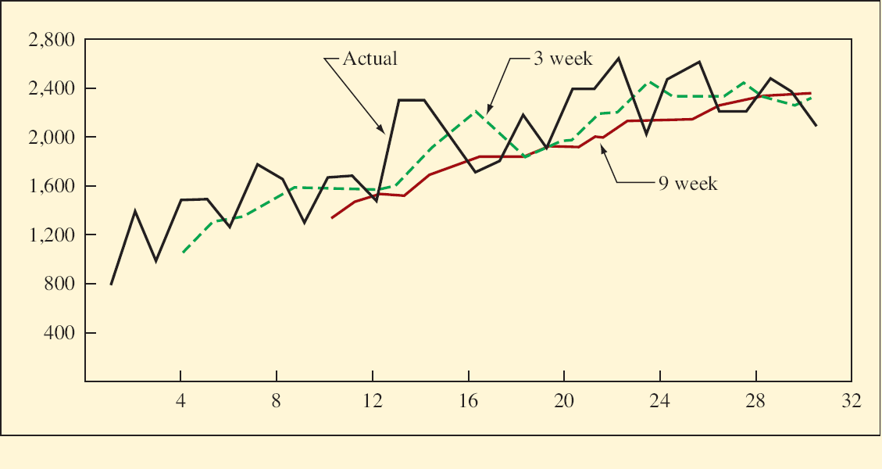
Simple moving average example

Slide 23
Weighted moving average
The moving average formula implies an equal weight being placed on each value that is being averaged
The weighted moving average permits an unequal weighting on prior time periods
All the weights must sum to one
w₁>w₂>w_{n}
$$F_{t}=w_{1}A_{t−1}+w_{2}A_{t−2}+⋯+w_{n}A_{t−n}$$

Slide 24
Weighted moving average example
Week | Demand | 3 Week | 3 Week | 3 Week
 |  |  | W₁=0.7, W₂=0.2, W₃=0.1 | W₁=0.5, W₂=0.3, W₃=0.2
1 | 800
2 | 1400
3 | 1000
4 | 1500 | 1067 | 1060 | 1080
5 | 1500 | 1300 | 1390 | 1330
6 | 1300 | 1333 | 1450 | 1400
7 | 1800 | 1433 | 1360 | 1400
8 | 1700 | 1533 | 1670 | 1590
9 | 1300 | 1600 | 1680 | 1650
10 | 1700 | 1600 | 1430 | 1520
11 | 1700 | 1567 | 1620 | 1580
12 | 1500 | 1567 | 1660 | 1620
13 | 2300 | 1633 | 1560 | 1600
14 | 2300 | 1833 | 2080 | 1940
15 | 2000 | 2033 | 2220 | 2140

Slide 25
Weighted moving average example

Slide 26
Choosing weights
Experience and trial-and-error are the simplest ways
Generally, the most recent past is the best indicator
When data are seasonal, weights should be established accordingly
The sales from the same period last time should be weighted the heaviest

Slide 27
Exponential smoothing
A weighted average method that includes all past data in the forecasting calculation
More recent results weighted more heavily
Does not require large amounts of historical data
Widely accepted because
Exponential models are surprisingly accurate
Formulating an exponential model is relatively easy
The user can understand how the model works
Little computation is required to use the model
Limited use of historical data

Slide 28
Exponential smoothing

Slide 29
Alpha smoothing constant
A value between 0 and 1 that is used to minimize the error between historical demand and respective forecasts
Use small values for α if demand is stable, larger values for α if demand is fluctuating
Adaptive forecasting
Two or more predetermined values of alpha
Computed values of alpha

Slide 30
First forecast
No way to find F₁ since F_{t} is a function of F_{t-1}
Estimate
The first period’s demand
Using an average of preceding periods, such as the average of the first two or three periods

Slide 31
Exponential smoothing example
Week | Demand | α=0.2 | α=0.6
1 | 800 | 800 | 800
2 | 1400 | 800 | 800
3 | 1000 | 920 | 1160
4 | 1500 | 936 | 1064
5 | 1500 | 1049 | 1326
6 | 1300 | 1139 | 1430
7 | 1800 | 1171 | 1352
8 | 1700 | 1297 | 1621
9 | 1300 | 1378 | 1668
10 | 1700 | 1362 | 1447
11 | 1700 | 1430 | 1599
12 | 1500 | 1484 | 1660
13 | 2300 | 1487 | 1564
14 | 2300 | 1650 | 2006
15 | 2000 | 1780 | 2182
F₄=F₃+ɑ(A₃-F₃)=920+0.2*(1000-920)=936
F₄=F₃+ɑ(A₃-F₃)=1160+0.6*(1000-1160)=1064

Slide 32
Exponential smoothing example

Slide 33
Exponential forecasts versus actual demand over time
Any forecast lag?

Slide 34
Trend effects in exponential smoothing
A trend in data causes the exponential forecast to always lag the actual data
Can be corrected somewhat by adding in a trend smoothing constant delta (δ)

Slide 35
Trend adjusted exponential smoothing

Slide 36
Trend adjusted exponential smoothing example
Week | Demand | F_{t} | T_{t} | FIT_{t}
1 | 800 | 700 | 100 | 800
2 | 1400 | 800 | 100 | 900
3 | 1000 | 1000 | 130 | 1130
4 | 1500 | 1104 | 122.2 | 1226
5 | 1500 | 1280.8 | 138.64 | 1419
6 | 1300 | 1435.2 | 143.5 | 1579
7 | 1800 | 1523.2 | 126.76 | 1650
8 | 1700 | 1680 | 135.76 | 1816
9 | 1300 | 1792.8 | 128.8 | 1922
10 | 1700 | 1797.6 | 91.48 | 1889
11 | 1700 | 1851.2 | 80.14 | 1931
12 | 1500 | 1884.8 | 66.28 | 1951
13 | 2300 | 1860.8 | 39.22 | 1900
14 | 2300 | 1980 | 63.22 | 2043
15 | 2000 | 2094.4 | 78.64 | 2173
α=0.2, δ=0.3

Slide 37
Trend adjusted exponential smoothing example

Slide 38
Forecast error
Projection of past trends into the future
Bias errors: consistent mistakes that cause a forecast to be too high or too low: wrong relationships, wrong trend line, errors in shifting seasonal demand or undetected trends
Random errors: errors that cannot be explained by the forecast model being used
Measures of error
Mean absolute deviation (MAD)
Mean error (ME)
Mean absolute percentage error (MAPE)

Slide 39
Mean absolute deviation (MAD)
Average forecasting error based on the absolute difference between actual and forecast demands
The ideal MAD is zero which would mean there is no forecasting error
The larger the MAD, the less the accurate the resulting model
A_{t} = Actual demand F_{t} = Forecast demand n = number of periods in forecast

Slide 40
Mean error (ME)
Average forecast error
Based on the arithmetic difference between actual and forecast demands
Increasing large error (+/-) indicates some systematic deficiency in the forecasting approach
Under-forecasted or over-forecasted

Slide 41
Mean absolute percentage error (MAPE)
Used to determine the forecasting errors as a percentage of the actual demand

Slide 42
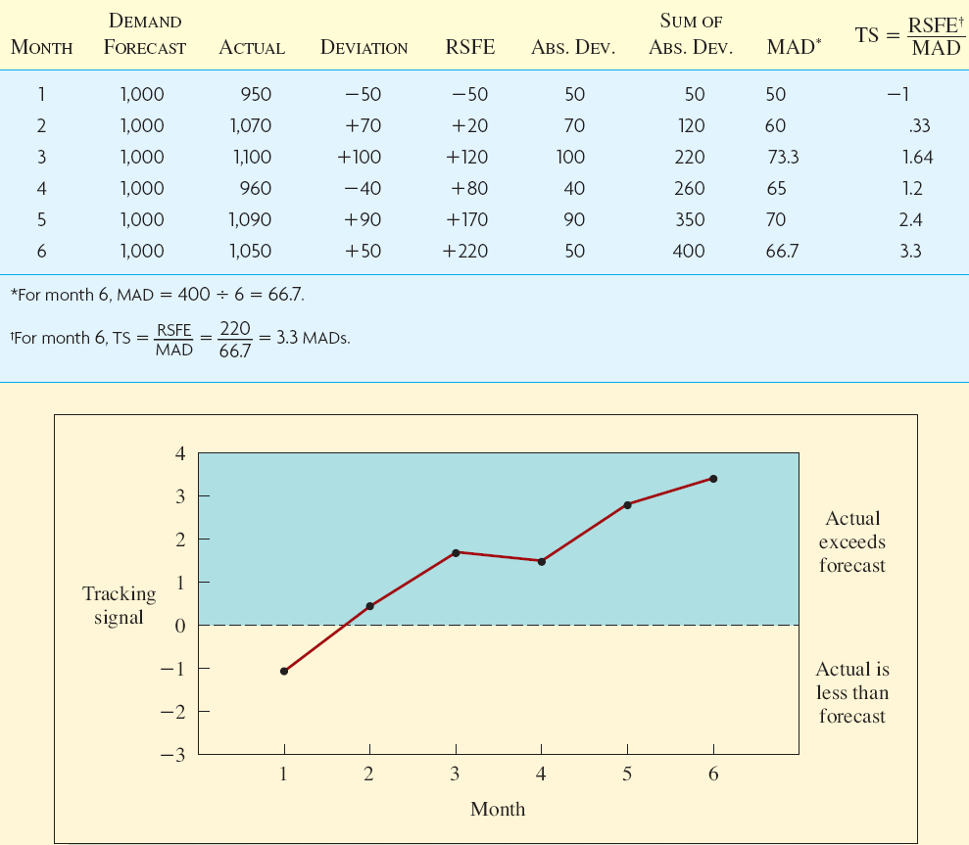
Forecast error example

Slide 43
Linear regression
Regression: functional relationship between two or more correlated variables
Linear regression analysis is used to predict Y given X
Y = a + bX
Y is the value of the dependent variable
a is the Y intercept
b is the slope
X is the independent variable
Assumes data falls in a straight line

Slide 44
Linear regression example

Slide 45
Linear regression example
Least squares regression line

Slide 46
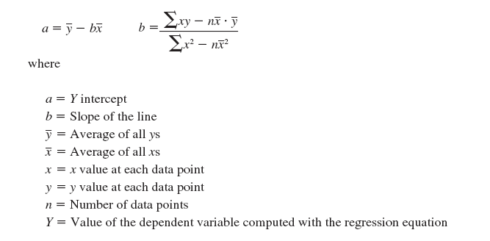
Linear regression example
Equations

Slide 47
Linear regression example
Y₁₃=441.66+359.6(13)=5116.5
Notes:
b=(268200-12*78/12*33350/12)/(650-12*(78/12)(78/12))=51425/143=359.615
a=33350/12-359.615*78/12=441.667
Y13=441.7+359.6(13)=5116.5

Slide 48
Linear regression example
Standard error of estimate
A measure of the dispersion of data about a regression line
How well (or closely) the regression line fits the data
…

Slide 49
Causal relationship forecasting
Using independent variables other than time to predict future demand
The independent variable must be a leading indicator
Must find those occurrences that are really the causes

Slide 50
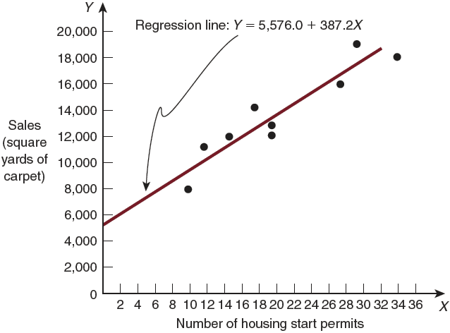
Causal relationship forecasting example

Slide 51
Causal relationship forecasting
Multiple regression analysis
Forecasting using more than one independent variable
Measuring the combined effects of several independent variables on the dependent variable
Y=a+b₁X₁+b₂X₂+b₃X₃

Slide 52
Applications of forecasting to service operations
Real-time data acquisition makes information immediately available to decision makers
Point-of-Sale (POS) equipment
Schedule workers for peak hours
Yield management
Attempts to maximize the revenues of a firm
Set the price based on demand of different customers
E.g., offer deals to customers who arrive during non-peak periods

Slide 53
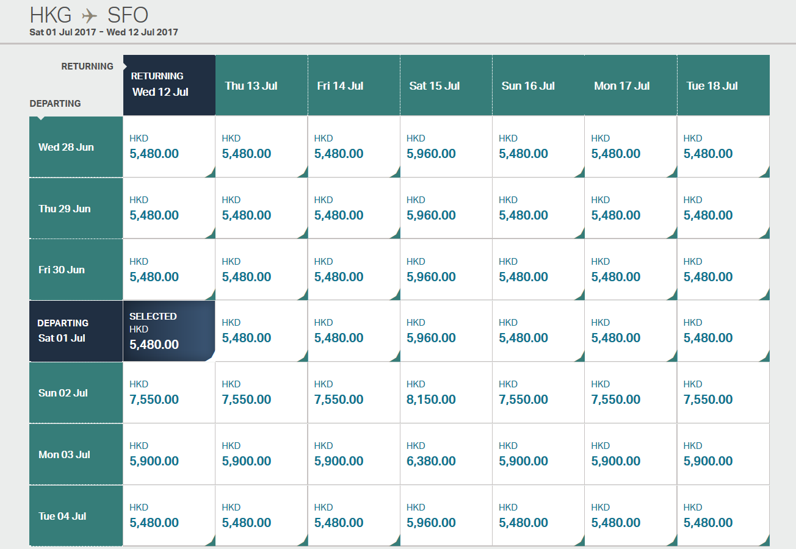
Cathay Pacific

Slide 54


Slide 55


